Slide 1
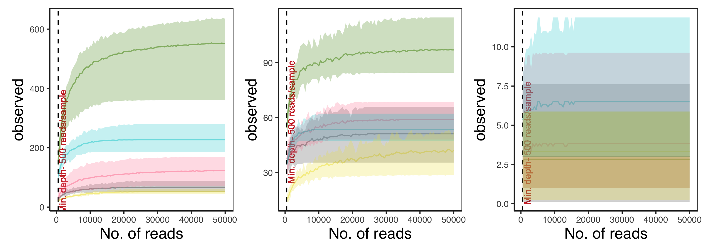
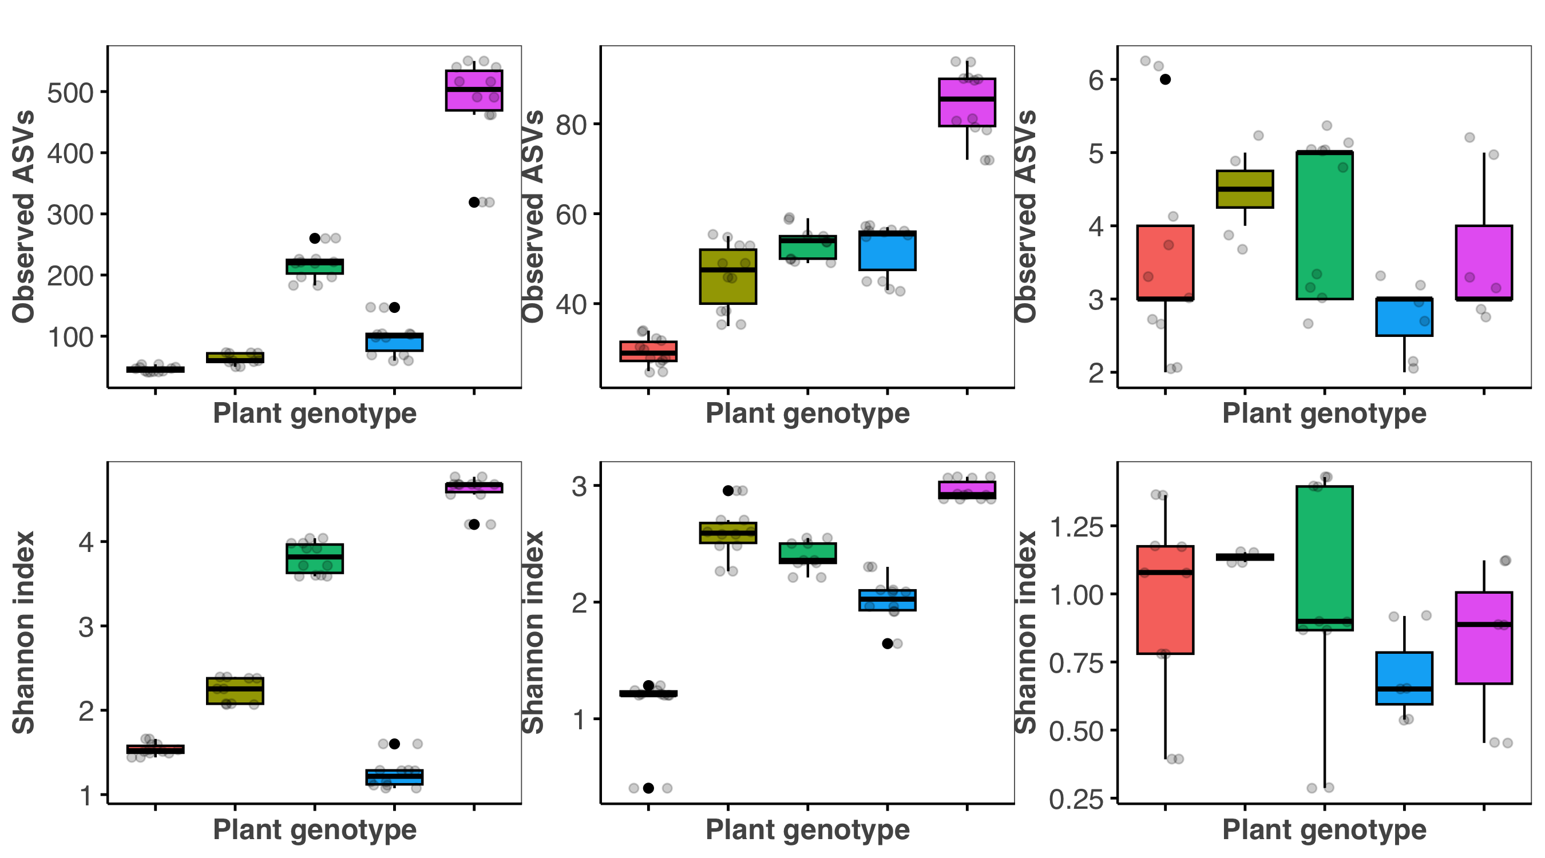
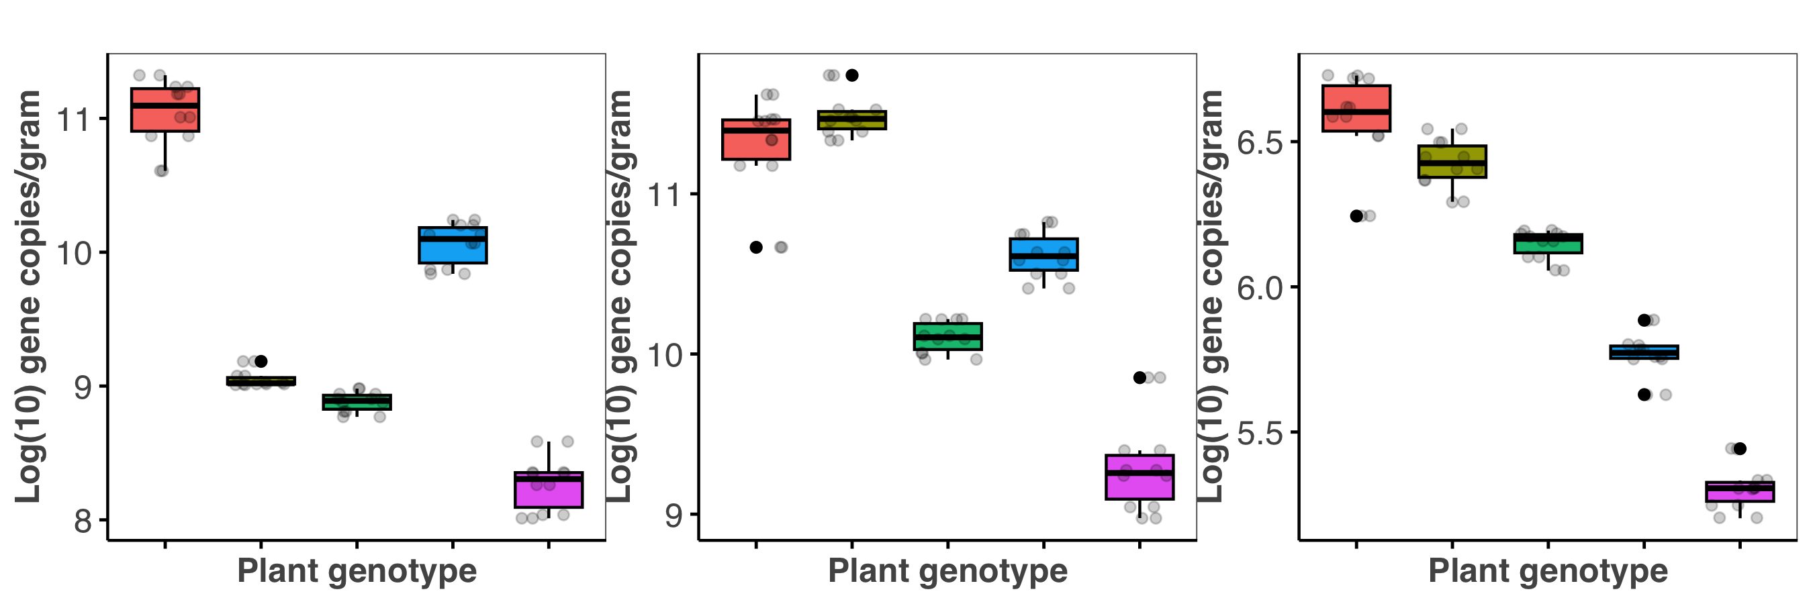
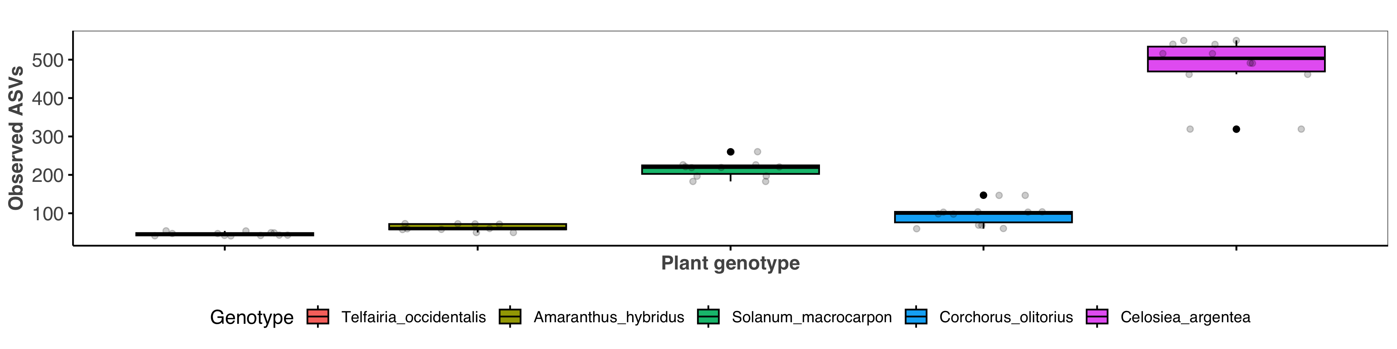
A
Bacterial community
E
Fungal community
I
Archaeal community
Richness
Richness
Richness
B
KW: p= 2.905e-05
c
F
KW: p= 0.04
b
J
KW: p= 0.496
a
a
a
ac
a
ab
ab
a
abc
a
a
b
ab
C
KW: p= 2.905e-05
a
G
KW: p= 0.02
a
K
a
a
KW: p= 0.496
ac
ab
abc
a
a
bc
a
abc
c
bc
b
D
c
KW: p= 1.325e-05
H
ac
a
KW: p= 0.001
L
b
KW: p= 2.905e-05
ab
bc
abc
abc
bc
ac
abc
ab
b
a
c
Telfairia occidentalis
Amaranthus hybridus
Solanum macrocarpon
Corchorus olitorius
Celosiea argentea

Slide 2
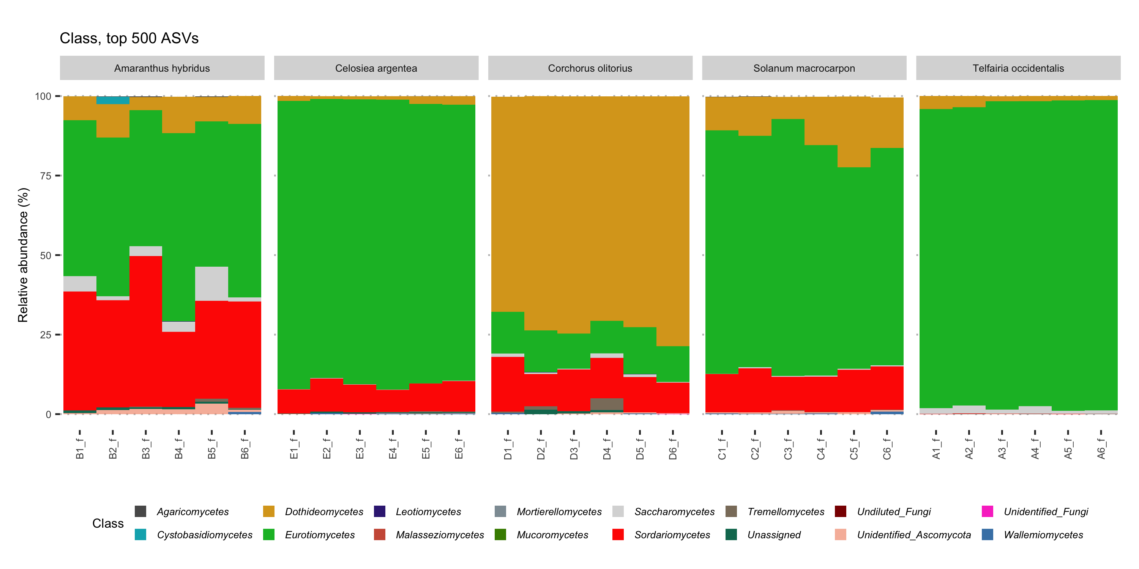
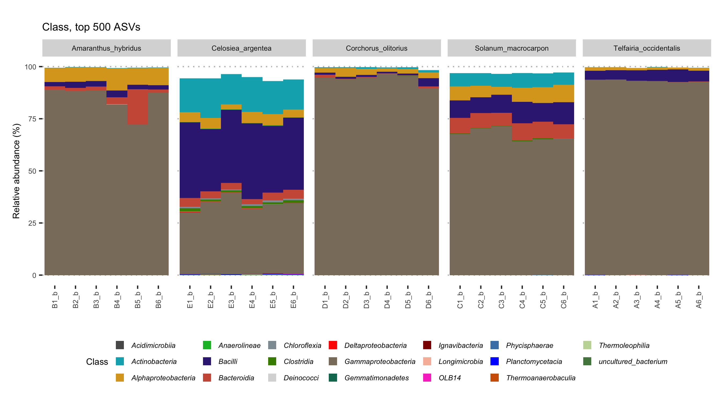
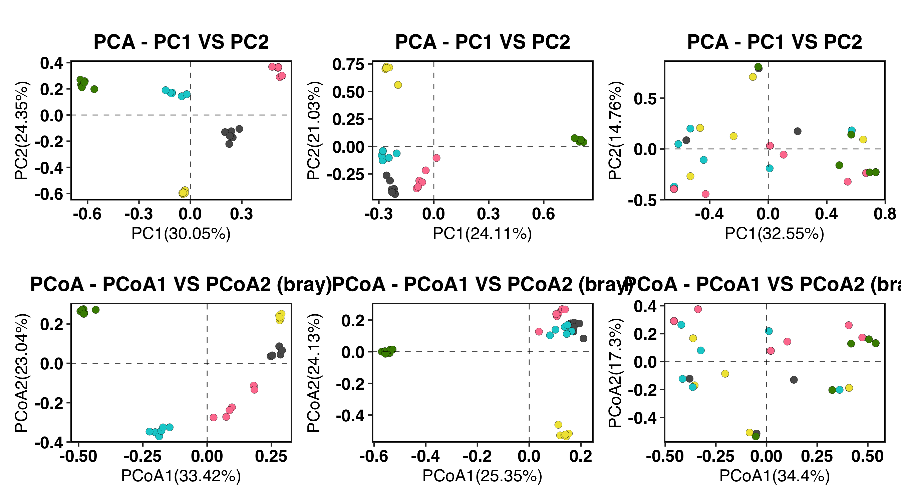
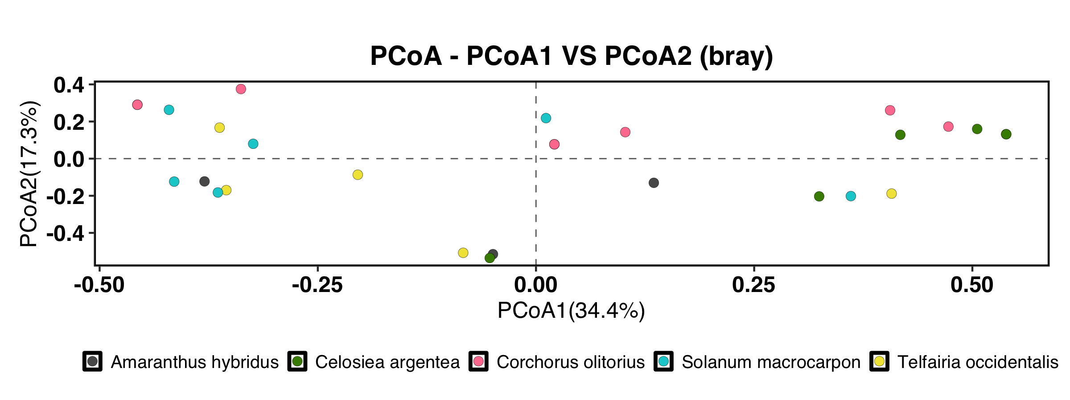
A
Amaranthus hybridus
Celosiea argentea
Corchorus olitorius
Solanum macrocarpon
Telfairia occidentalis
Samples
B
Amaranthus hybridus
Celosiea argentea
Corchorus olitorius
Solanum macrocarpon
Telfairia occidentalis
Samples
C
BACTERIAL COMMUNITY
E
FUNGAL COMMUNITY
G
ARCHAEL COMMUNITY
D
F
H
R²=0.85,
p=0.001
R²=0.76,
p=0.001
R²=0.24,
p=0.012
Amaranthus hybridus
Celosiea argentea
Corchorus olitorius
Solanum macrocarpon
Telfairia occidentalis

Slide 3
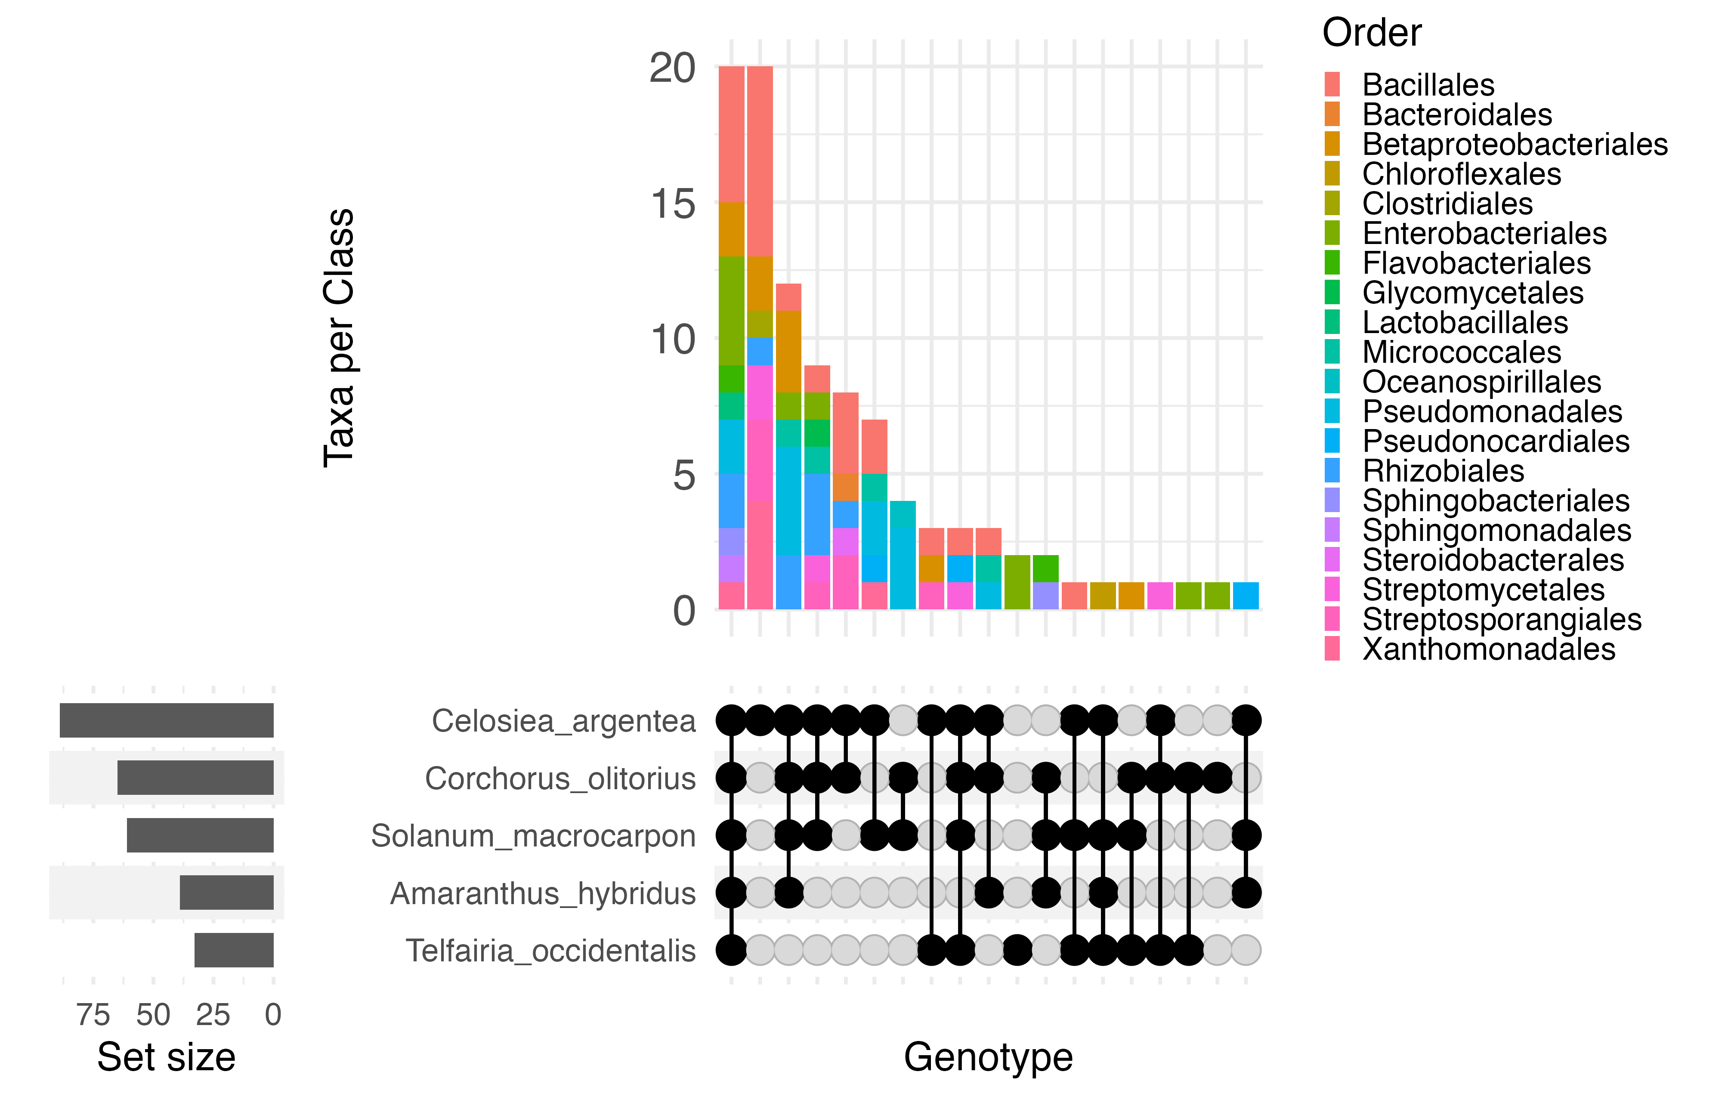
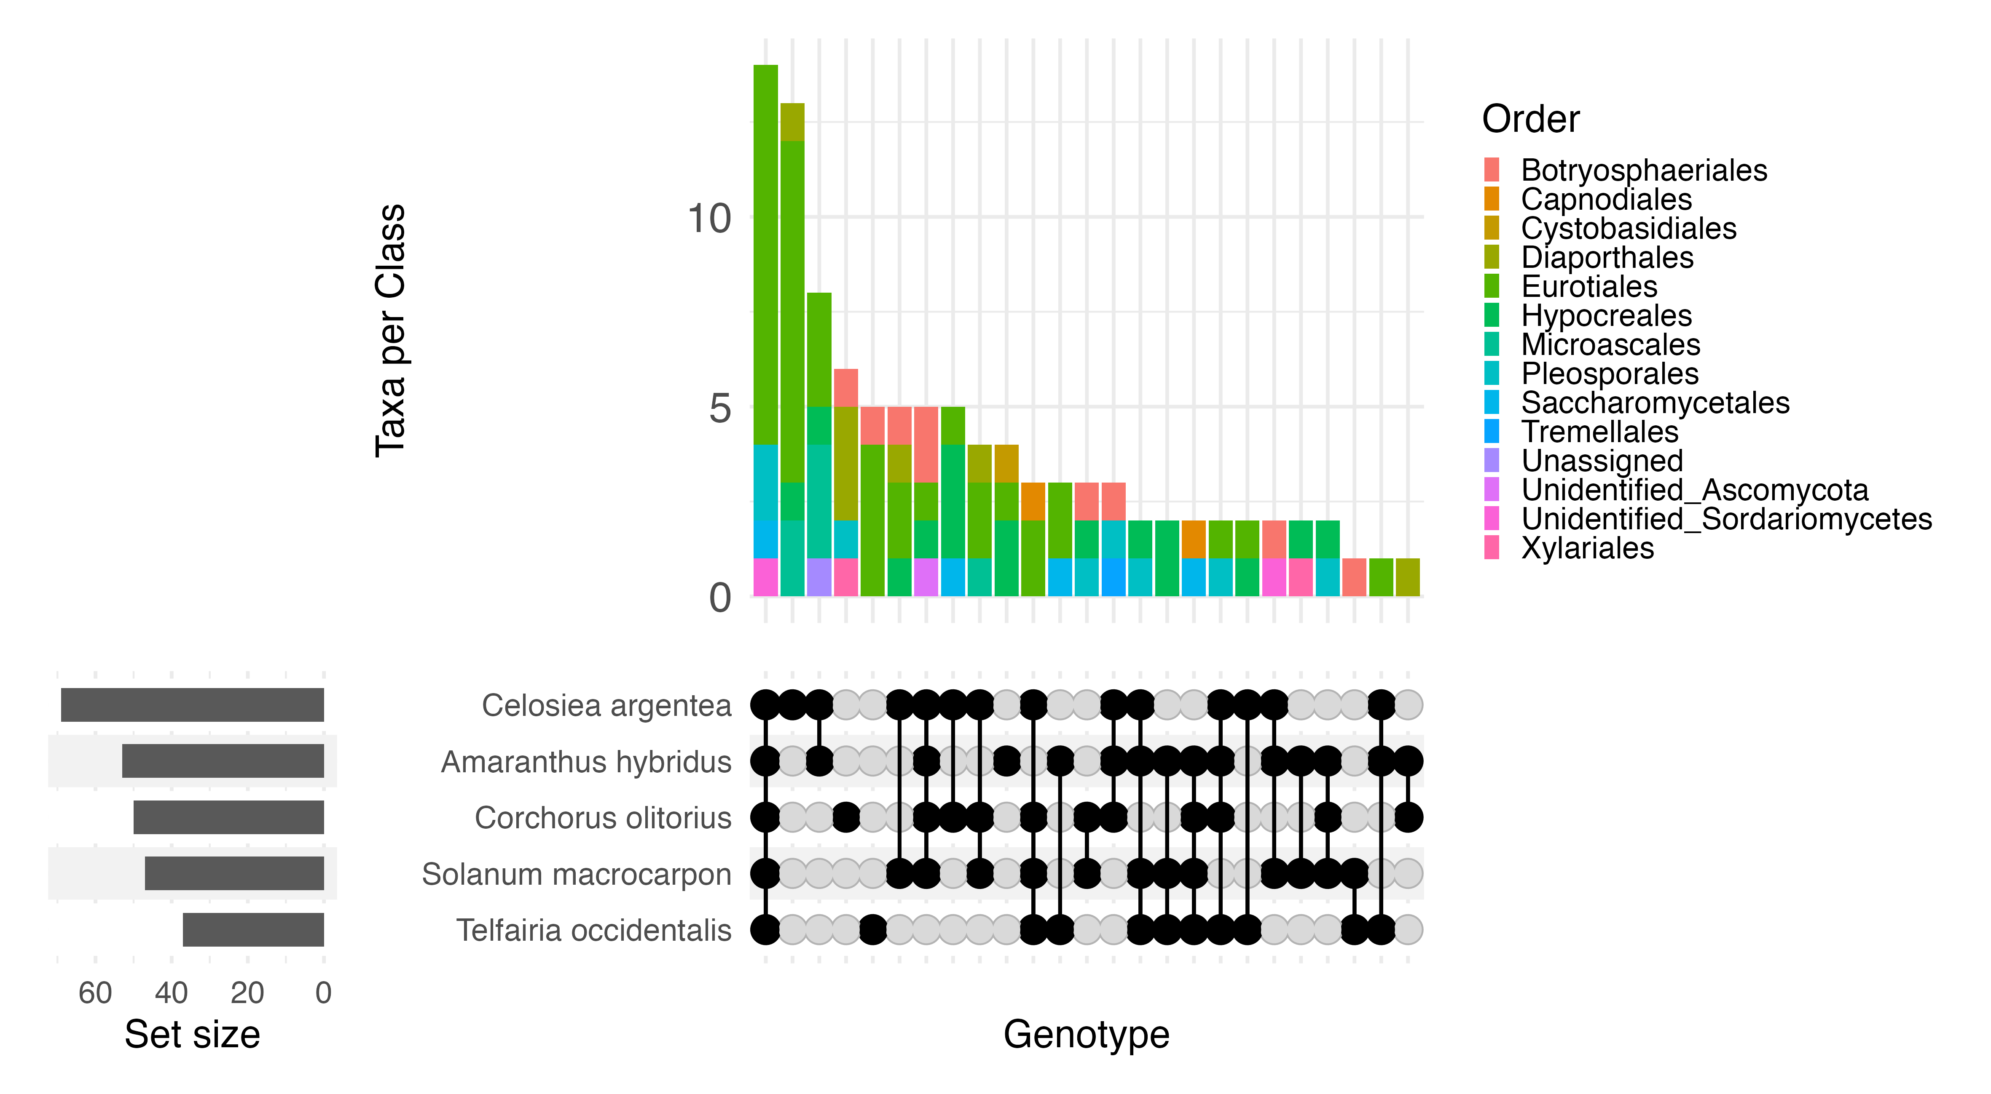
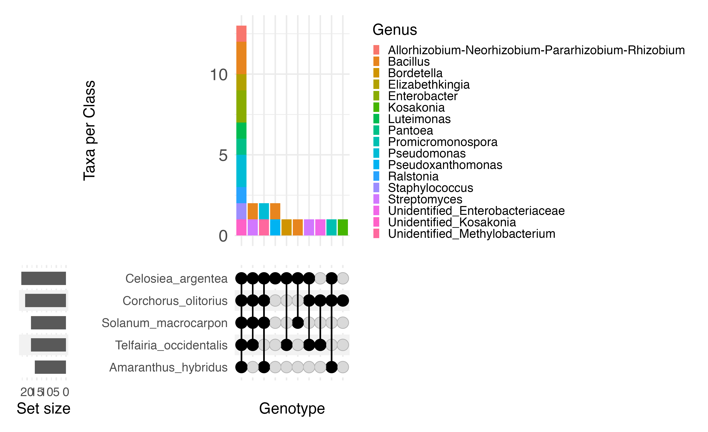
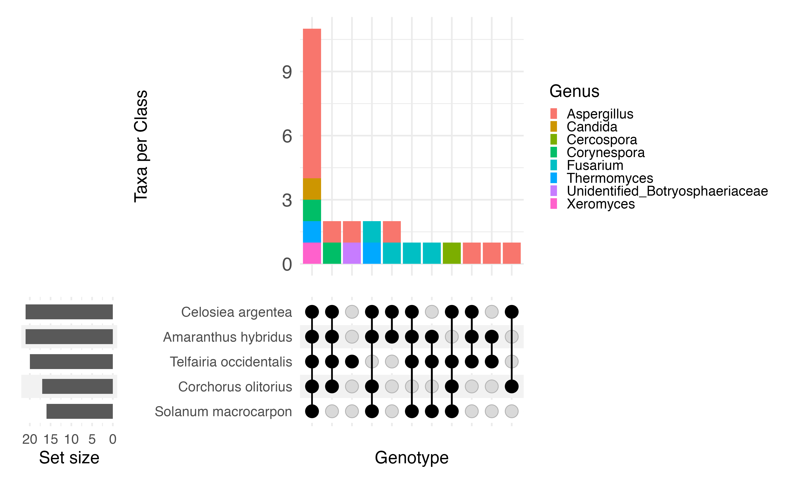
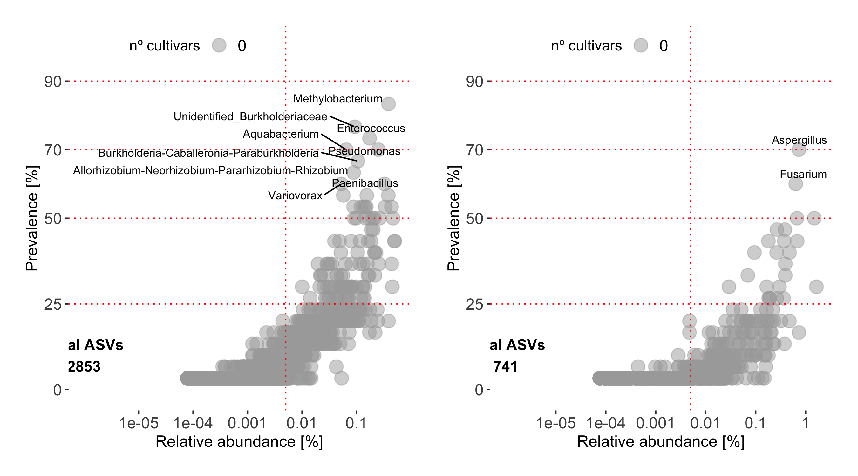

BACTERIAL COMMUNITY
D
A
FUNGAL COMMUNITY
Orders
Orders
Celosiea argentea
Celosiea argentea
Corchorus olitorus
Corchorus olitorus
Solanum macrocarpon
Solanum macrocarpon
Amaranthus hybridus
Amaranthus hybridus
Telfairia occidentalis
Telfairia occidentalis
B
Genera
E
Genera
Celosiea argentea
Celosiea argentea
Corchorus olitorus
Amaranthus hybridus
Solanum macrocarpon
Telfairia occidentalis
Telfairia occidentalis
Corchorus olitorus
Amaranthus hybridus
Solanum macrocarpon
C
n°
genotypes
25
50
75
100
F
n°
genotypes
25
50
75
100
Total ASVs
2853
Total ASVs
741
Total ASVs

Slide 4
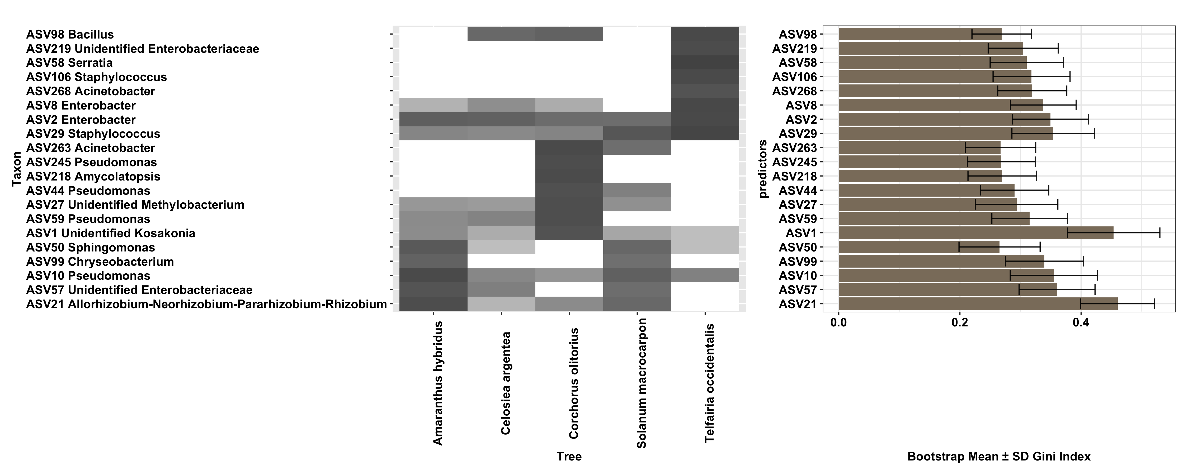
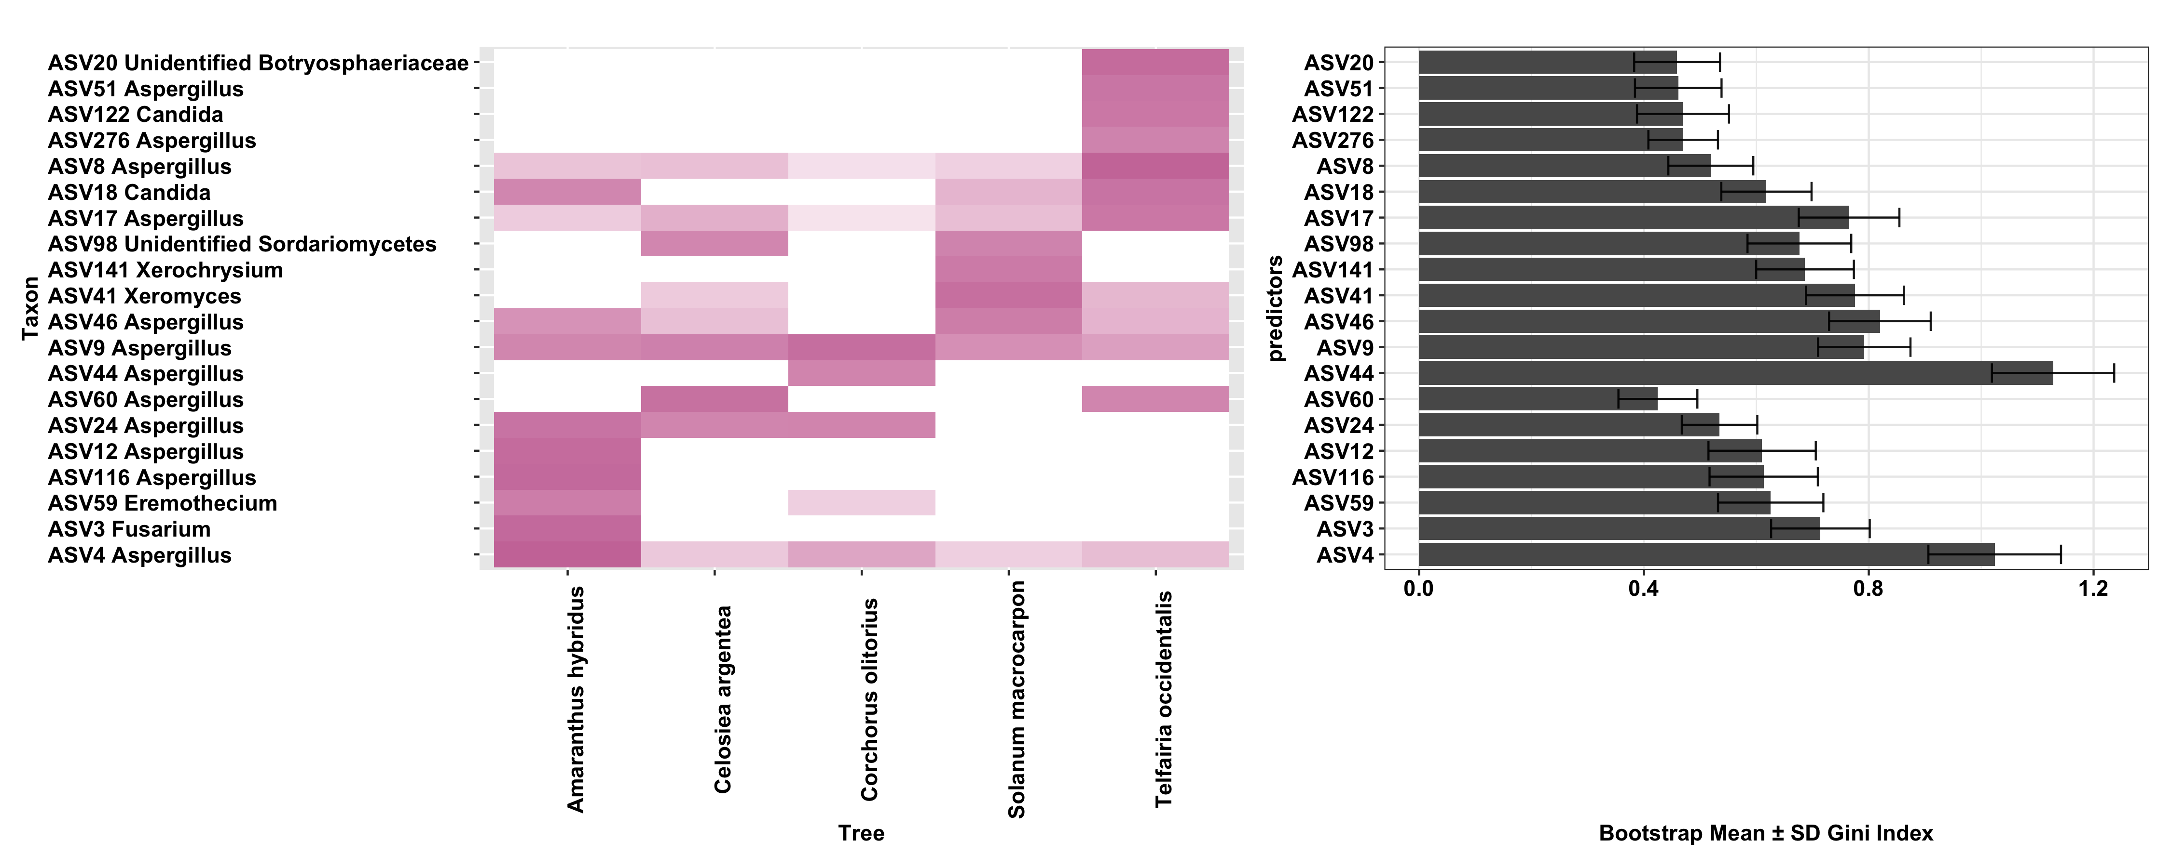
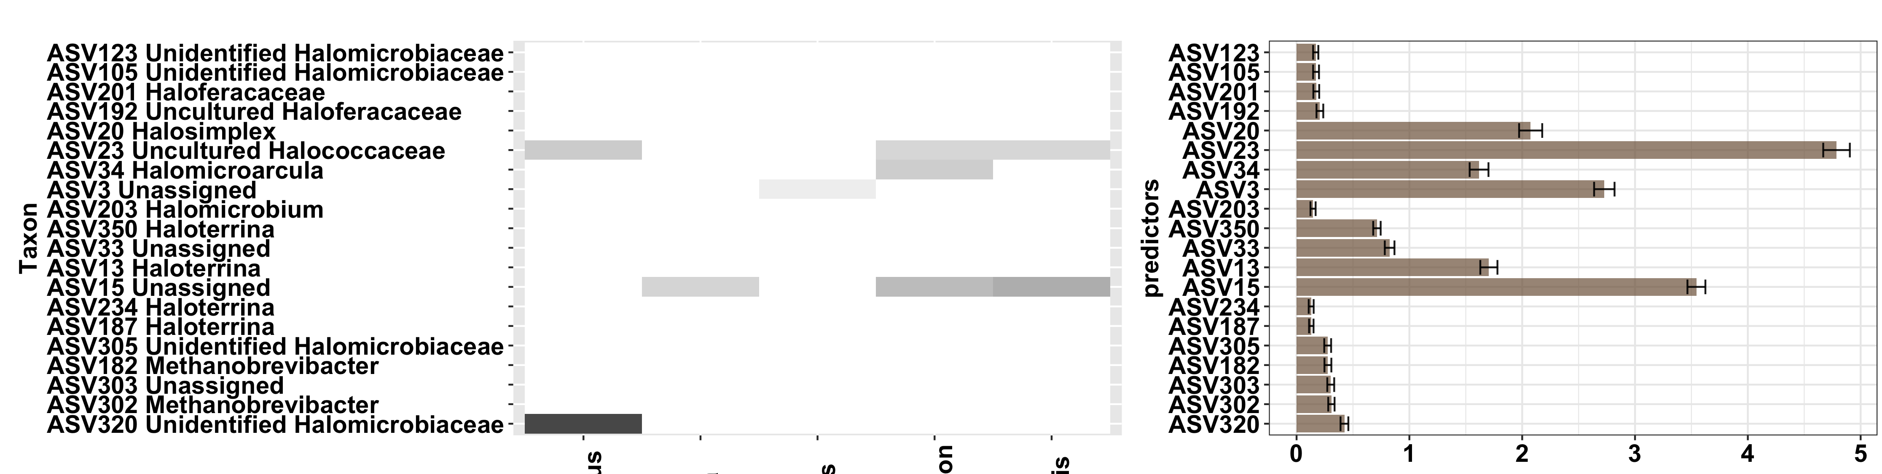
Bootstrap Mean ± SD Gini Index
Amaranthus hybridus
Celosiea argentea
Corchorus olitorius
Solanum macrocarpon
Telfairia occidentalis

Slide 5
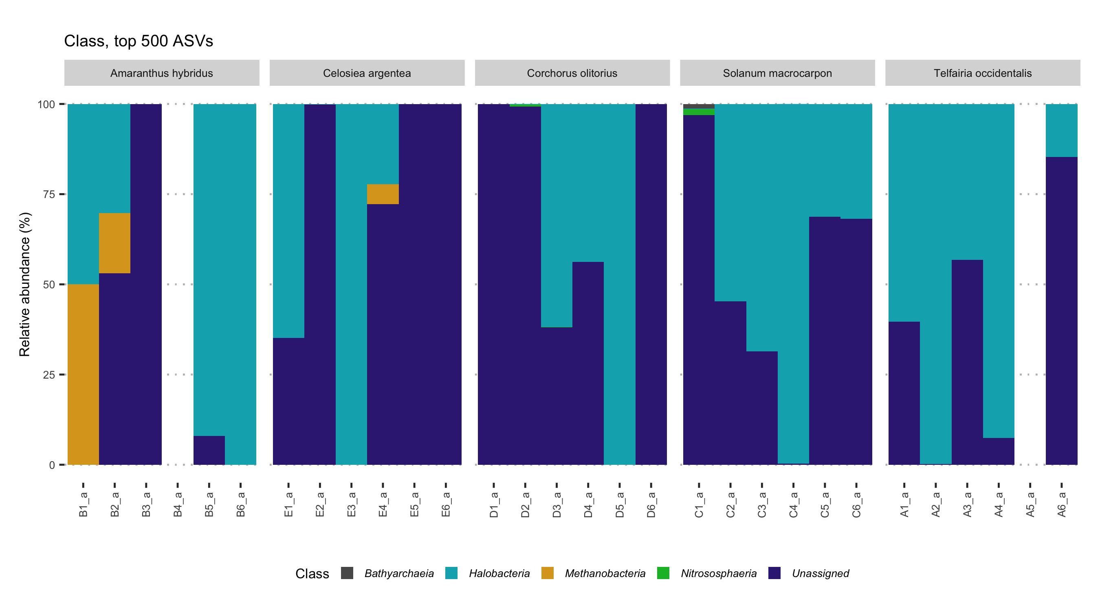
Amaranthus hybridus
Celosiea argentea
Corchorus olitorius
Solanum macrocarpon
Telfairia occidentalis
Samples

